Slide 1
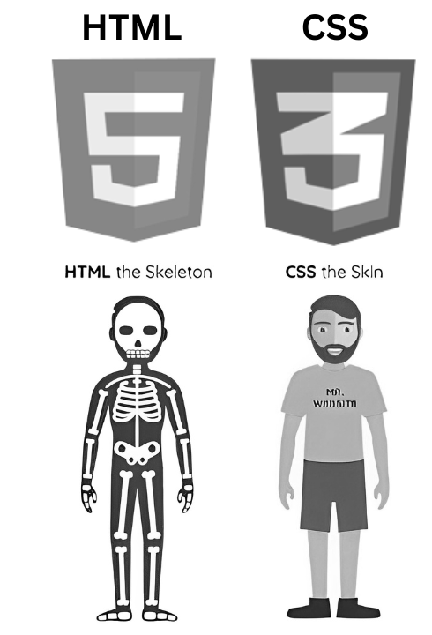
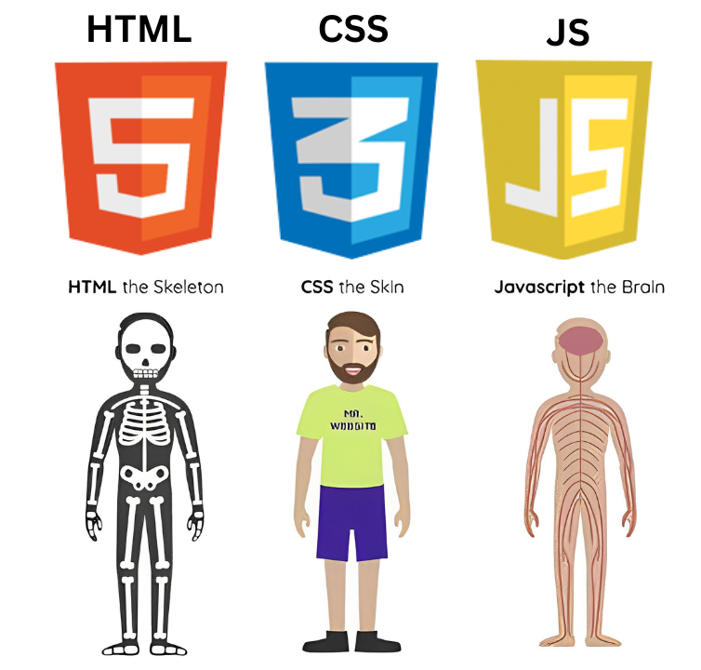
WEB DESIGN
W9 – JavaScript

Slide 2

OBJECTIVES FOR TODAY
JavaScript Ecosystem
What can JavaScript do?
Basic JavaScript Syntax
Understand variables, data types, and operators.
Learn control structures: conditionals and loops.
Explore JS object syntax.

Slide 3
EXPLAIN
How JS contribute to Web apps?
HTML tags are essential components that create elements on a webpage.
CSS is employed to enhance the visual style and layout of web pages
JavaScript is employed to introduce interactivity and functionality to web pages.

Slide 4
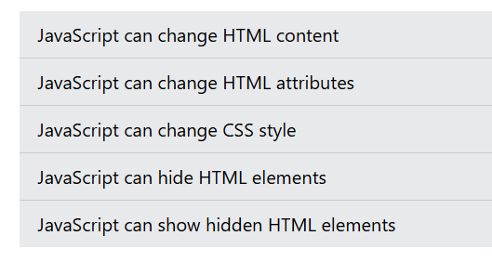

ACTIVITY
What can JavaScript do?
Explore the 5 bellow examples of JavaScript usage in an HTML page
https://www.w3schools.com/js/js_examples.asp

Slide 5
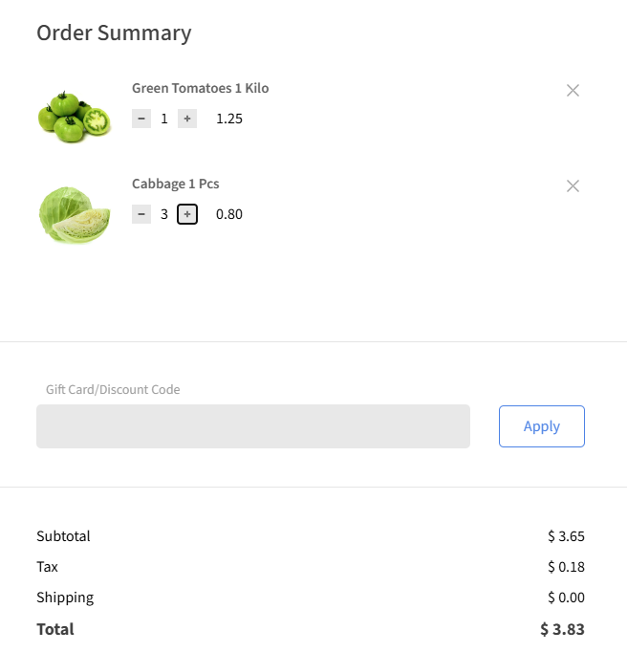
EXPLAIN
What JS can bring to a Web Application?
https://codepen.io/leonam-silva-de-souza/pen/RwXZVQr
Check the code !
Remove item from the list
Dynamically update the total price

Slide 6


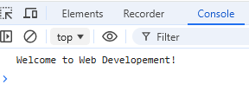
EXPLAIN
Your first JS program in 3 steps
Chrome or any other Web Browser can execute JavaScript code while loading HTML
STEP 1 - Create a index.html file, that links to a index.js file:
STEP 2 - Write some JS code
<!DOCTYPE html>
<html>
<head>
<title>Let s run JS on a Browser</title>
<script src='index.js'></script>
</head>
<body>
</body>
</html>
// Example of JS code, printing on console
const courseName = "Web Developement";
console.log("Welcome to " + courseName + "!");
STEP 3 - Open your index.html on a browser and check the console view

Slide 7
EXPLAIN
JavaScript is a language:
Dynamically typed
Interpreted
Types are checked at runtime
No compilation process
The types can change as the program runs.
The code runs as soon as the JavaScript engine reads it.

Slide 8
EXPLAIN
JS Syntax - Example 1
Let’s analyze the bellow code
let
const
String
Number
Boolean
Conditions
let username = "John"; // let - Can be reassigned
const isLoggedIn = true; // const - Cannot be reassigned
let greeting = "Hello, " + username; // String
let age = 25; // Number
let isAdult = age >= 18; // Boolean
console.log(greeting); // "Hello, John"
console.log("Is adult:", isAdult); // true
if (isLoggedIn) { // Condition
if (isAdult) {
console.log(`${username} is an adult and logged in.`); // Print on console
} else {
console.log(`${username} is not an adult but logged in.`);
}
} else {
console.log("User is not logged in.");
}

Slide 9
EXPLAIN
JS Syntax - Example 2
Let’s analyze the bellow code
let
String
Number
Boolean
Conditions
Loops
let name = "Alice"; // String
let balance = 100; // Number
let isPremiumUser = false; // Boolean
balance += 50; // Add 50 to the balance
let hasEnoughBalance = balance >= 100;
if (hasEnoughBalance) { // Condition
console.log(`${name} has enough balance: $${balance}`); // String interpolation ($)
} else {
console.log(`${name} needs more funds.`);
}
for (let i = 1; i <= 5; i++) { // Loops
console.log(`Transaction ${i}: $${i * 10}`);
}

Slide 10
EXPLAIN
JS Syntax - Example 3
Let’s analyze the bellow code
let
Array
Object
Conditions
Loops
Function
let hasMembership = true;
let favoriteBooks = ["1984", "To Kill a Mockingbird", "The Great Gatsby"]; // Array
let user = { // Object
name: userName,
age: userAge,
membership: hasMembership,
books: favoriteBooks
};
function displayUserInfo(user) { // Function Definition
console.log(`Membership: ${user.membership ? "Active" : "Inactive"}`); // Access to object member
console.log("Favorite Books:");
for (let book of user.books) { // For-of to loop on array members
console.log(`- ${book}`);
}
}
if (user.membership) { // Condition
displayUserInfo(user); // Function call
} else {
console.log("User does not have an active membership.");
}

Slide 11

What will the code print?
let numbers = [10, 20, 30, 40, 50];
let sum = 0;
for (let i = 0; i < numbers.length; i++) {
if (numbers[i] % 20 === 0) {
sum += numbers[i];
}
}
console.log(sum);
1
2
3
4
0
20
60
150
Notes:
c

Slide 12
What will the code print?
let numbers = [10, 20, 30, 40, 50];
let sum = 0;
for (let i = 0; i < numbers.length; i++) {
if (numbers[i] % 20 === 0) {
sum += numbers[i];
}
}
console.log(sum);
1
2
3
4
0
20
60
150
Notes:
c

Slide 13
What will the code print?
let user = {
name: "Ronan",
age: 25,
membership: "premium"
};
if (user.age > 18 && user.membership === "premium") {
console.log(`${user.name} has a premium membership.`);
} else {
console.log(`${user.name} does not have a premium membership.`);
}
1
2
3
4
Ronan has a premium membership.
Ronan does not have a premium membership
Error
Ronan is the Best
Notes:
c

Slide 14
What will the code print?
let user = {
name: " Ronan",
age: 25,
membership: "premium"
};
if (user.age > 18 && user.membership === "premium") {
console.log(`${user.name} has a premium membership.`);
} else {
console.log(`${user.name} does not have a premium membership.`);
}
1
2
3
4
Ronan has a premium membership.
Ronan does not have a premium membership
Error
Ronan is the Best
Notes:
c

Slide 15
What will the code print?
let products = [
{ name: "Phone", price: 300 },
{ name: "Tablet", price: 500 },
{ name: "Laptop", price: 1000 }
];
for (let product of products) {
if (product.price > 400) {
console.log(product.name);
}
}
1
2
3
4
Phone
Tablet
Tablet
Laptop
Phone
Table
Laptop
Notes:
c

Slide 16
What will the code print?
let products = [
{ name: "Phone", price: 300 },
{ name: "Tablet", price: 500 },
{ name: "Laptop", price: 1000 }
];
for (let product of products) {
if (product.price > 400) {
console.log(product.name);
}
}
1
2
3
4
Phone
Tablet
Tablet
Laptop
Phone
Table
Laptop
Notes:
c

Slide 17
Objects in JavaScript are
dynamic key-value collections
{ key: value, key: value }

Slide 18
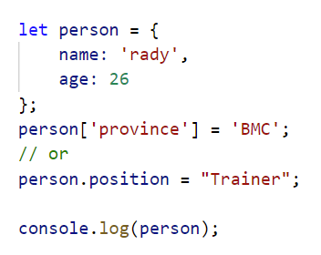
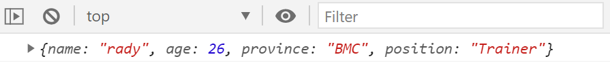
EXPLAIN
Objects can be dynamically updated
Output

Slide 19
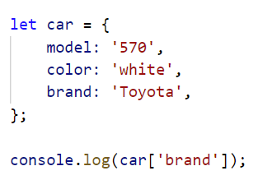
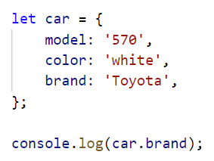
EXPLAIN
Object attribute access
BRACKETS SYNTAX
DOT SYNTAX

Slide 20
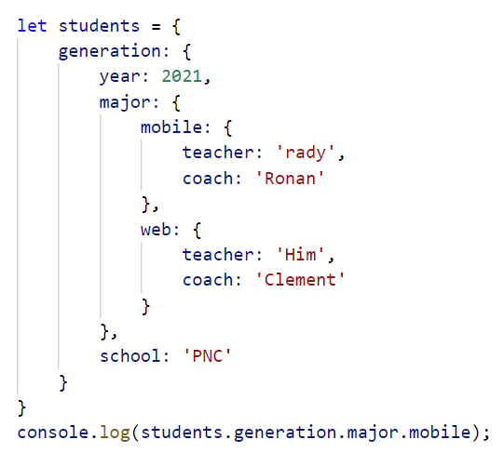
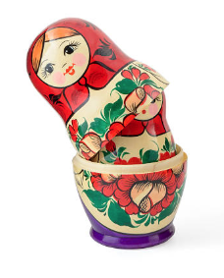
EXPLAIN
Objects can be nested

Slide 21
What this code will print ?
Notes:
a

Slide 22
WHAT WE HAVE LEARNT
JavaScript Ecosystem
What does JS bring to front end?
Where does JS run on front end?
JavaScript Syntax
Understand JS language paradigms
Understand variables, data types, and operators.
Learn control structures: conditionals and loops.
Explore functions and basic event handling.

Slide 23


SOME GREAT JAVASCRIPT RESSOURCES
https://cstart.mines.edu/web/Day2/2-JavaScriptBasicSyntax.pdf
https://www.integral-domain.org/lwilliams/mis462/JavaScript.pdf
https://www.gurukultti.org/admin/notice/javascript.pdf
https://www.w3schools.com/js/default.asp

